Slide 1

Agile from the Trenches
A story about agile based on real facts
By Juanjo Cerezuela,
Lead Software Craftsman at Ve Interactive
@PliyoSenpai

Slide 2
Enrich your book of spells

Slide 3
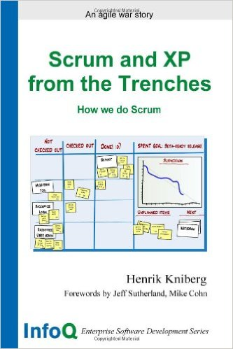
The book that inspired the title of this presentation

Slide 4
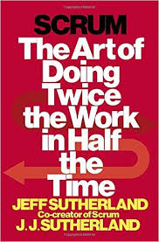
The book that taught me the most about agile

Slide 5
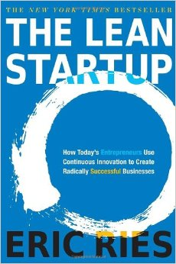
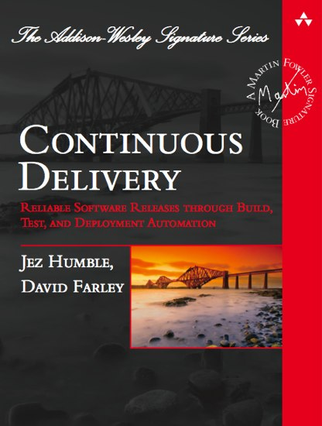
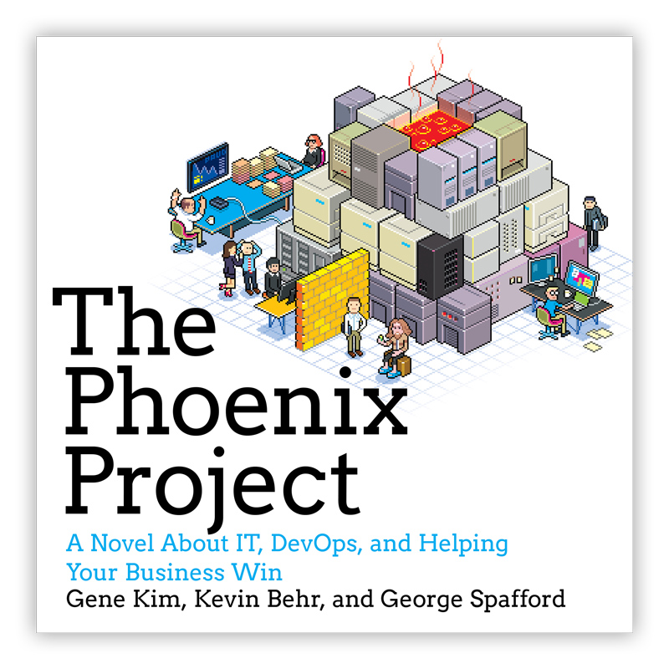
Other inspirational books out there

Slide 6

Other inspirational talks out there
The Land that Scrum Forgot, by Uncle Martin

Slide 7
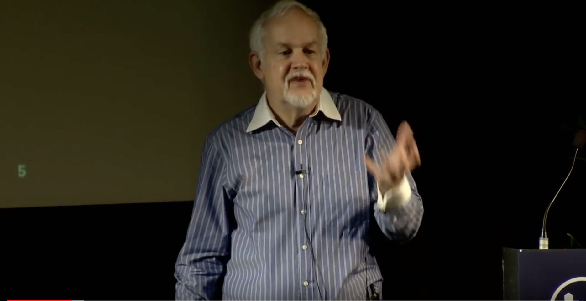
Other inspirational talks out there
How to enable organizations to go faster, by Fred George

Slide 8
Now that you know my little birds let’s go for the story of how we evolved our understanding of agile

Slide 9
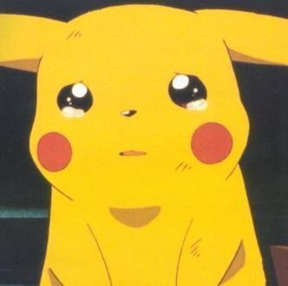
How everything started
Manual Deployments
No Products Owners
Fixed Deadlines without commitment
No automated testing
Lack of business visibility
No plan
No definition of roles
“You are not allowed to” attitude

Slide 10
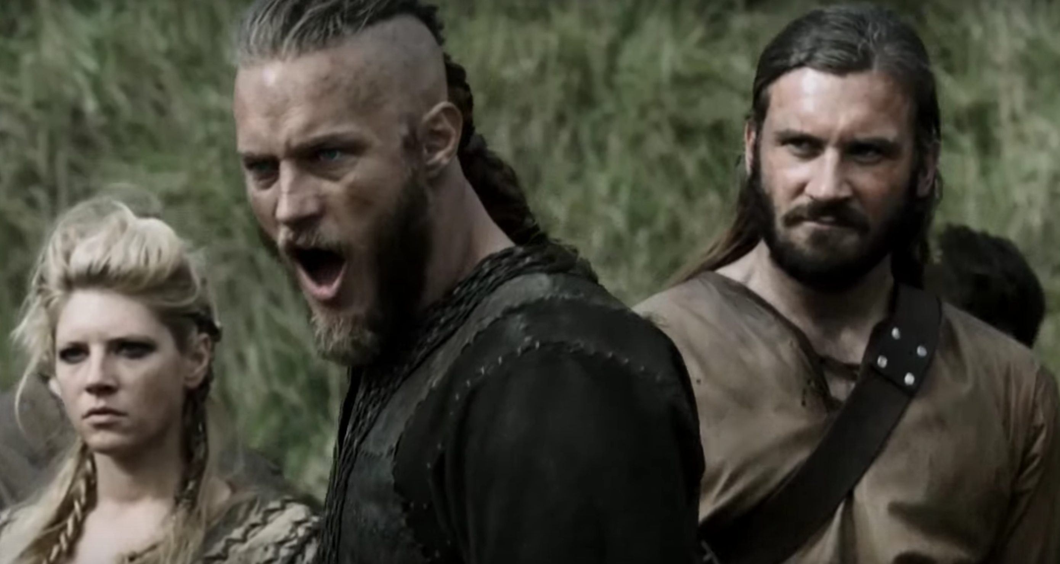
How we applied Agile
Leadership

Slide 11
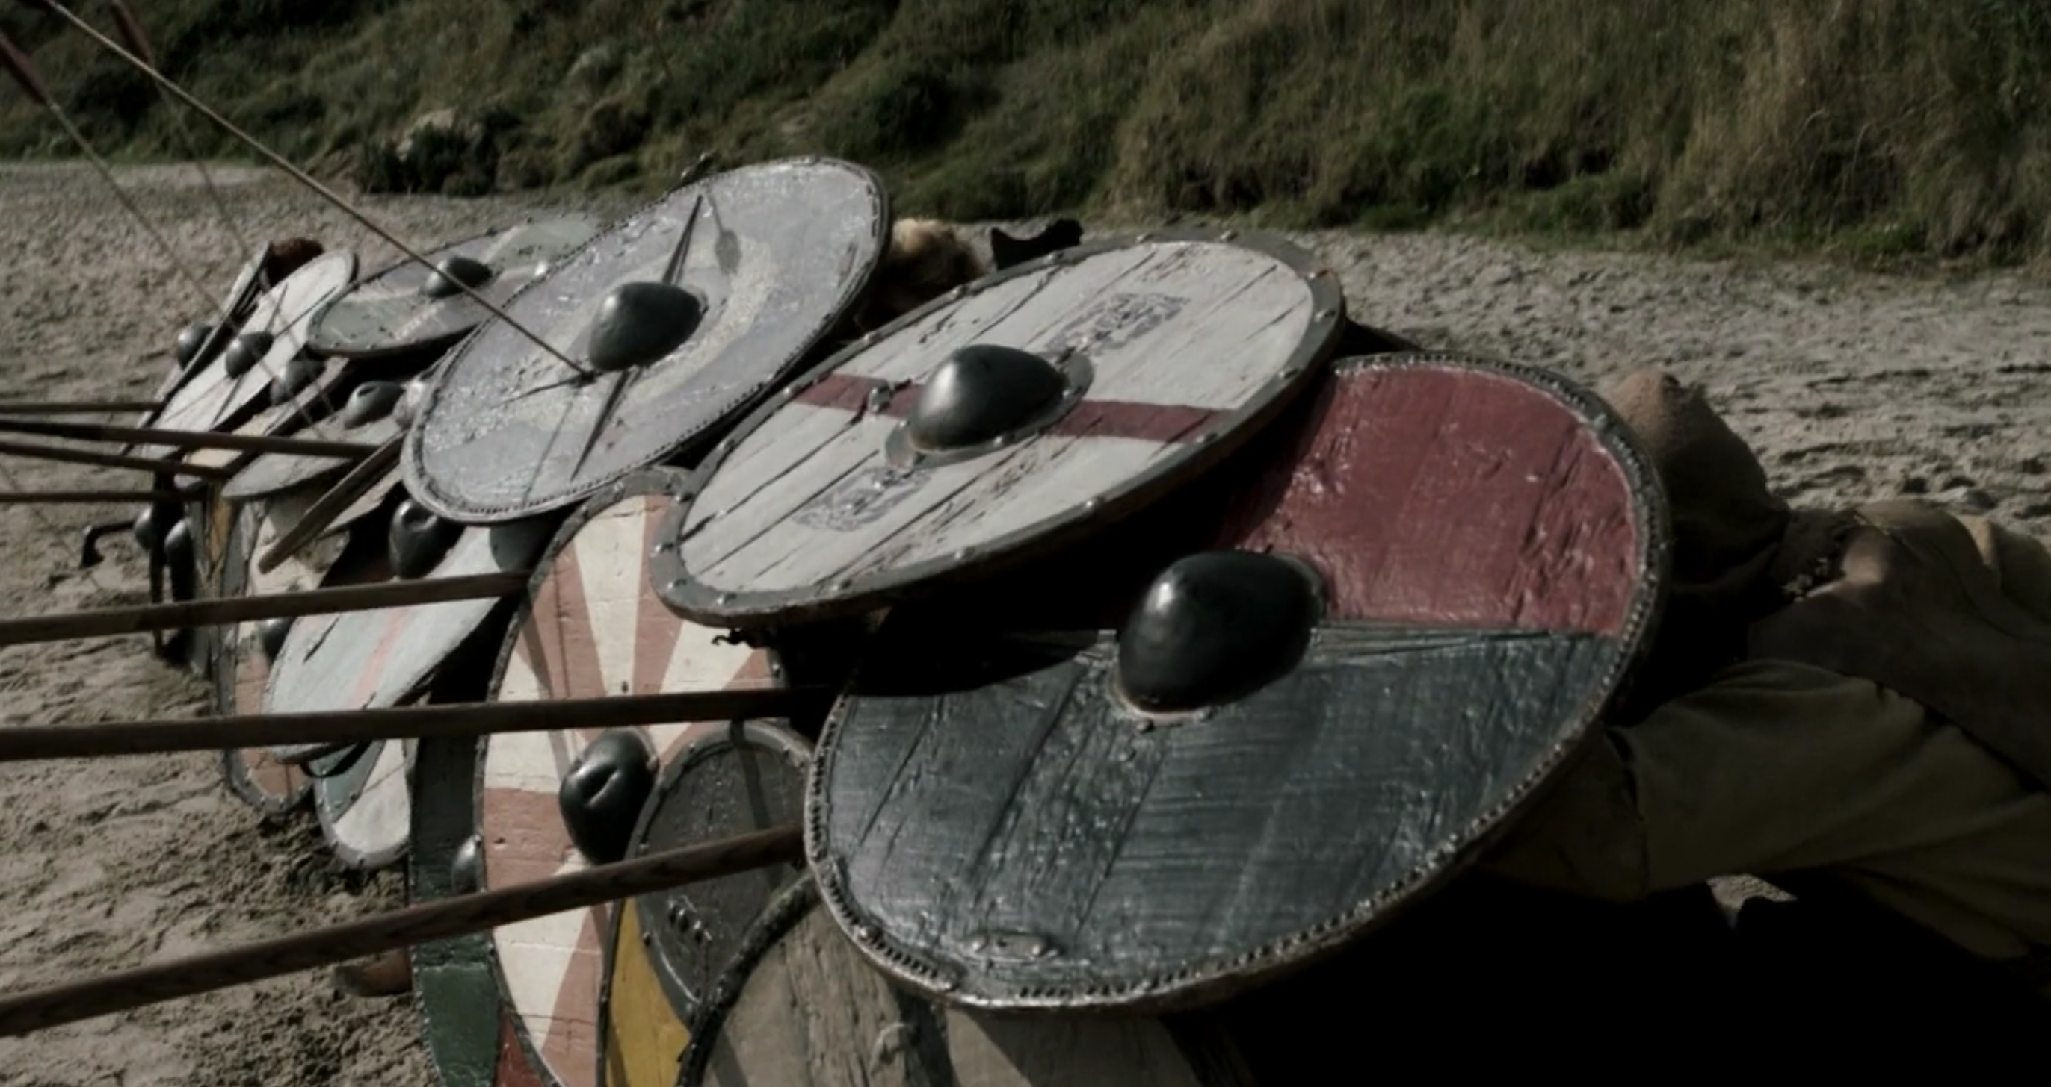
SHIELD WALL !
Cohesion

Slide 12
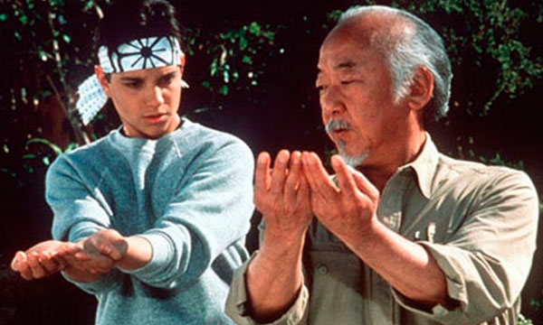
Very first steps
Two weeks iterations.
Retrospectives.
Sense of leadership.
Pair programming.
Code reviews.
Deploying from our machine.
Best practices
Code guidelines.
Estimations in ideal days.
Sense of velocity. Burndown charts.
Coaching everywhere, from bottom to top.

Slide 13
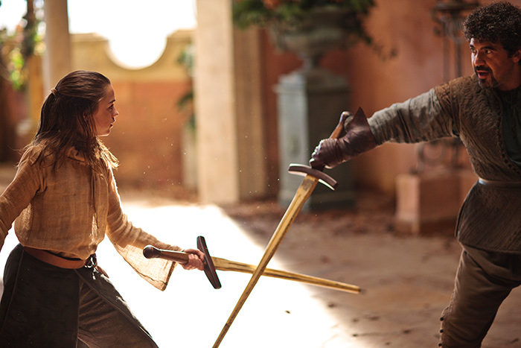
Once we started running
Release management (Octopus).
TDD.
Multiple environments.
(CI, PRE, PRO)
Cross functional teams.
Fear cuts deeper than swords!

Slide 14
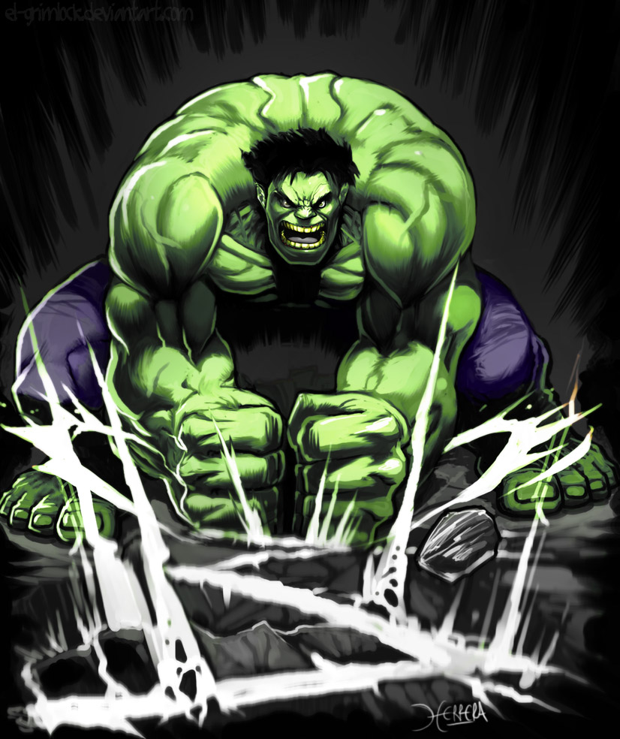
Top of the line
Pull requests! (GIT)
Metrics (Grafana)
Exceptions logs! (Application Insights)
Continuous Delivery!
One week iterations! Microservices!
Alerts!
DEV OPS!

Slide 15
Next steps
Alerts based on knowledge.
Improve acceptance tests code base: Real scenarios for the win. Containers. Open source mind set. Leads. (Champions).
Steering groups.
Trust over estimations.

Slide 16
What’s the quintessence of agile?
Answer the following questions constantly
1. How can we go faster?
2. How can we deliver software with better quality?
3. What are the other companies doing to achieve 1 and 2?
4. Is happiness related to the way we understand agile?
5. Culture over processes and People over products.
6. Find time for point 3. Reflect. Act.

Slide 17
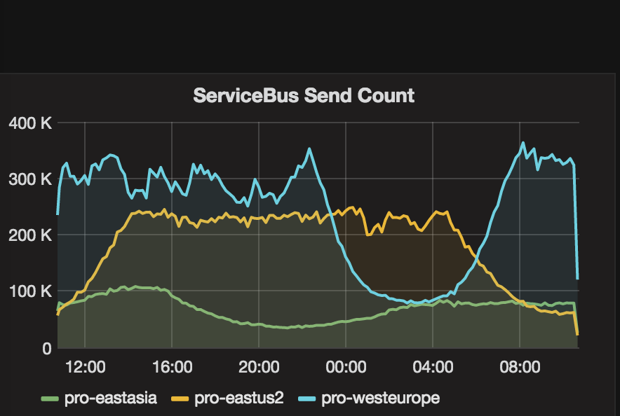
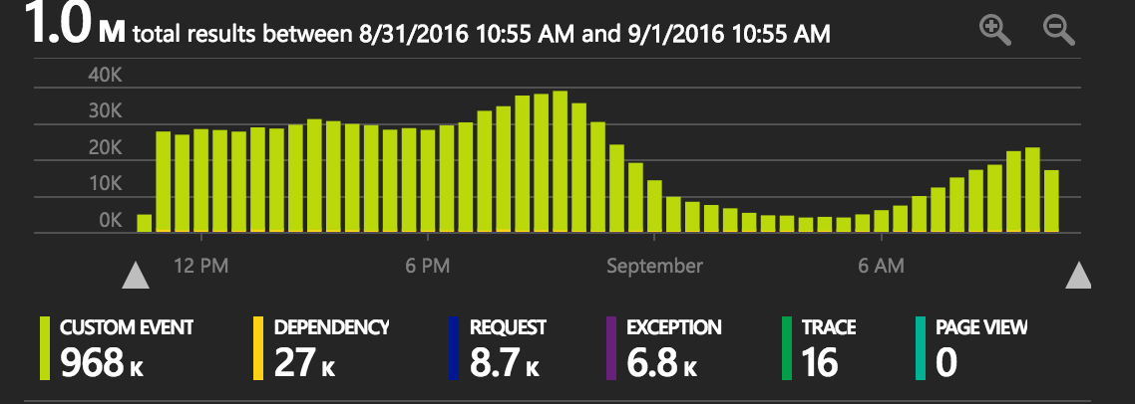
How our metrics looks like

Slide 18
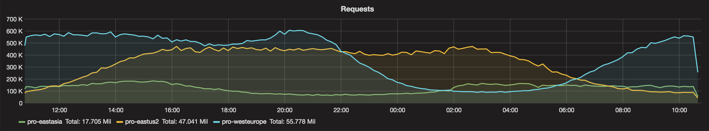
How our metrics looks like

Slide 19
Base your culture in metrics that matters.

Slide 20
And remember, There is nothing written in stone

Slide 21
Thanks for watching!

